Slide 1
STUART ANDREWS
Senior Financial Adviser
This presentation includes information on products and services from which we make money

Slide 2

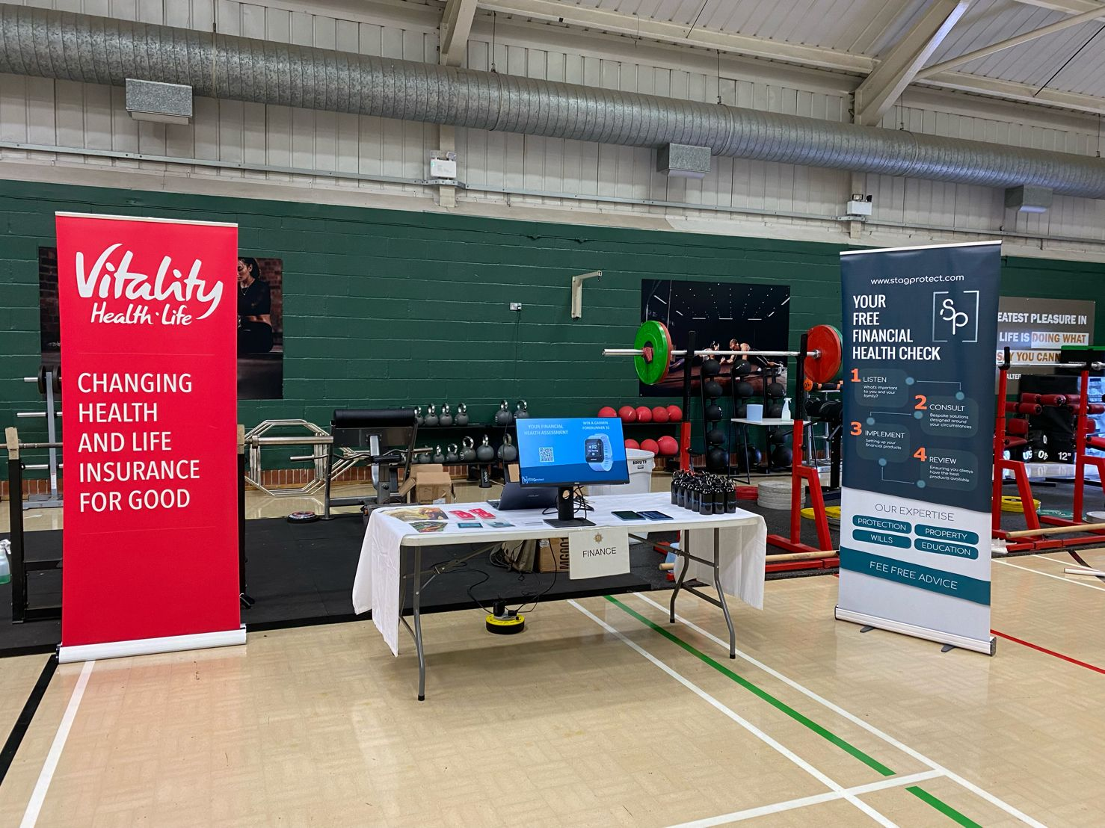

WHY ARE WE HERE
Financial Knowledge Gaps for Forces Families

Slide 3
DEBT MANAGEMENT

Slide 4
DEBT
WHAT WE CAN AND CAN’T HELP WITH
We Can
We Can’t
Help you budget
Signpost debt services
Arrange loans for you

Slide 5
DEBT
WHY SHOULD YOU CARE
The Average person in the UK has £8,000 of debt
If you have debt, let’s help you clear it
6,000,000 people believe they will never be debt free

Slide 6
DEBT
DEBT FREEDOM FRAMEWORK
Debt Freedom
Budget planner
Trim the Fat
Earn Extra
Re-mortgage
Debt Deals
Over Pay

Slide 7




CREDIT SCORE
WHY IS IT IMPORTANT
Your financial CV
Can you borrow and pay back
Lenders review when you apply for:
Loans
Credit Cards
Car Finance
Phones
Mortgages

Slide 8
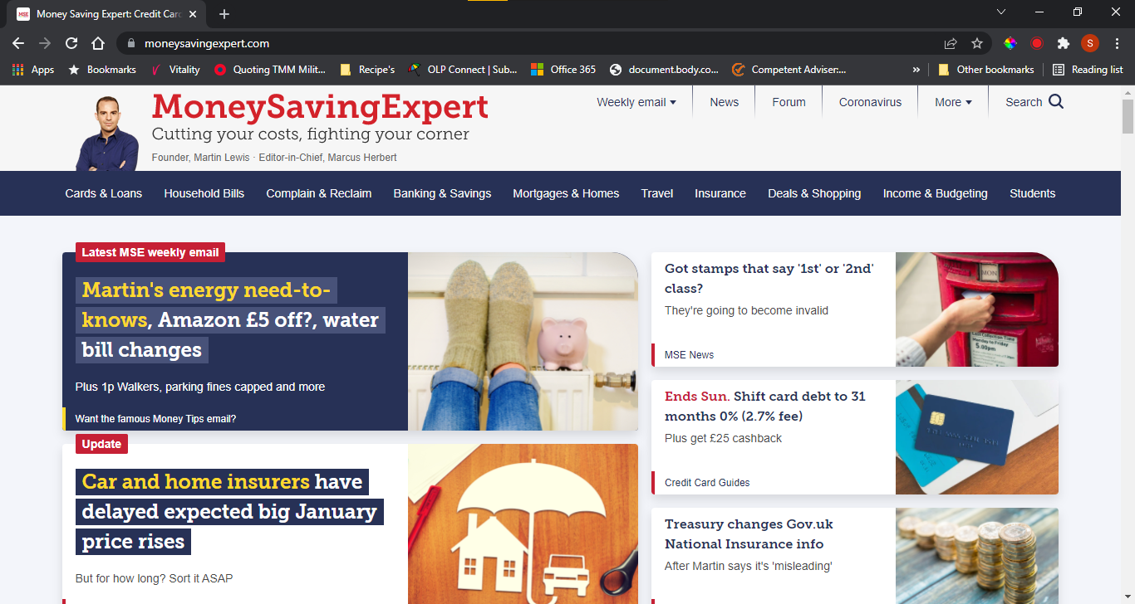
DEBT
SHOPPING AROUND

Slide 9
DEBT
WHAT TO AVOID
Pay Day Loans
Provider | APR
Mr Lender | 1239.2%
Piggy Bank | 1270.0%
Sunny Loans | 1293.0%
Borrow £400 – you could owe £5,172 in 12 months

Slide 10




DEBT
WHO CAN HELP

Slide 11
SAVINGS

Slide 12
SAVINGS
ACHIEVING LONG TERM GOALS
Identify Objective
Spare Cash
Save First Then Spend
Do your budget
Success

Slide 13
SAVINGS
FINDING SPARE CASH
Booze
Smokes
Coffee
10 pints per week at £4.50 per glass of wine
20 smokes a day at £13 a packet
1 coffee a day at £2.80
£45 per week
£91 per week
£19.60 per week
£2,340 per year
£4,732 per year
£1,022 per year

Slide 14
SAVINGS
FINDING SPARE CASH
Booze
Smokes
Coffee
£2,340 per year
£4,732 per year
£1,022 per year
Don’t forget to look after yourself

Slide 15
BUDGETING
WHY BOTHER
Likely to save for the future
Spend less than you earn
Achieve long term goals

Slide 16
BUDGETING
PLAN THE YEAR
Yearly big spends
Vehicle
Holiday
Move spare money into a separate account on the first day of the month
Christmas
Birthdays
Anything else?

Slide 17
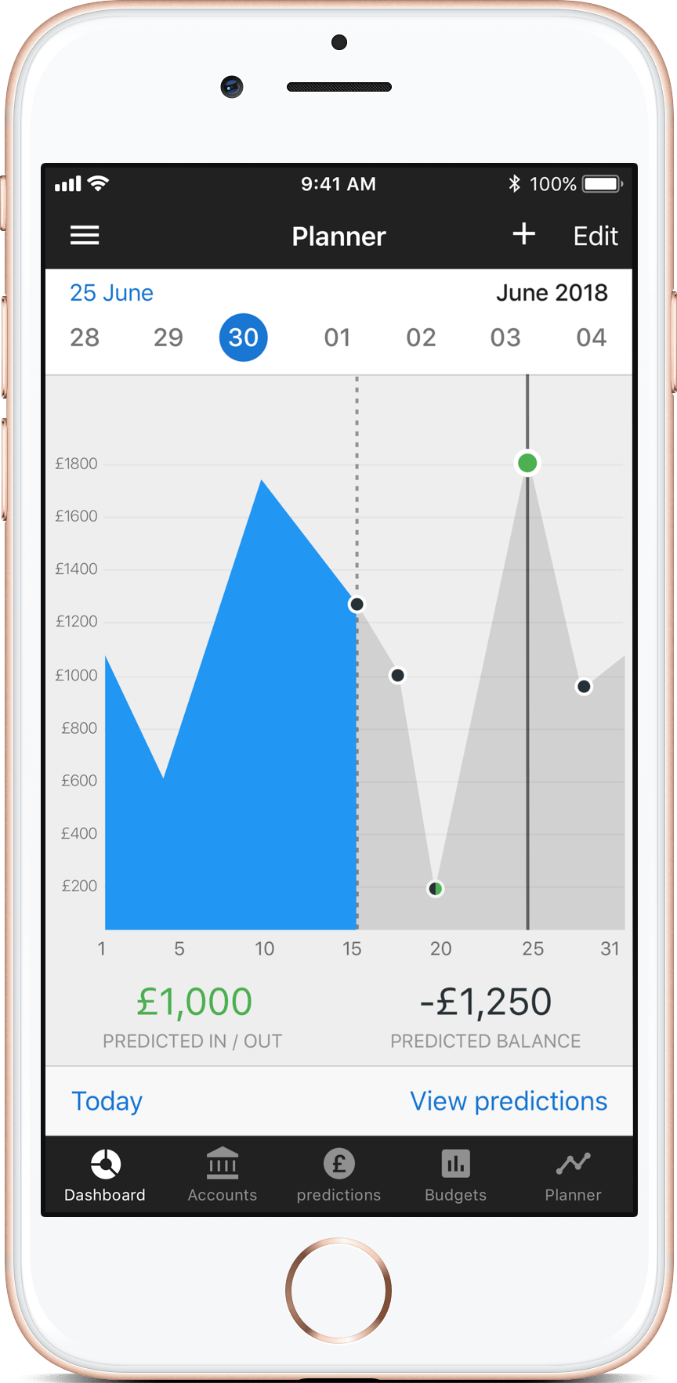
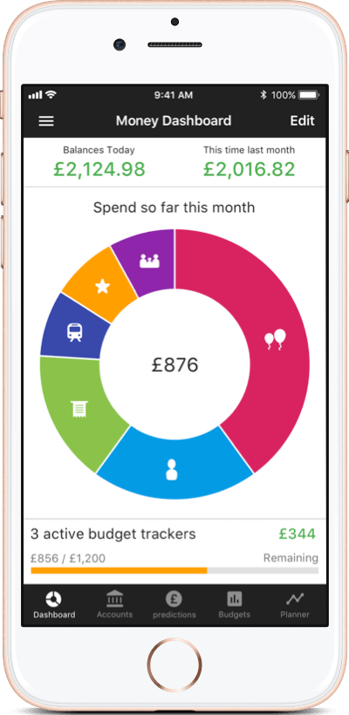




BUDGETING
HOW TO KEEP A BUDGET
Pen & Paper
A good start
Spreadsheet
Get our free download
Banking Apps
The future

Slide 18
MORTGAGES

Slide 19
MORTGAGES
ADVISORY NOTE
The following is for guidance only and cannot be considered advice

Slide 20

MORTGAGES
GETTING READY TO APPLY
Current accounts in the black
Proof of earnings
Electoral Roll
Avoid CCJs IVAs Payday loans
Avoid short term credit
Close unused accounts
Check credit file for errors

Slide 21
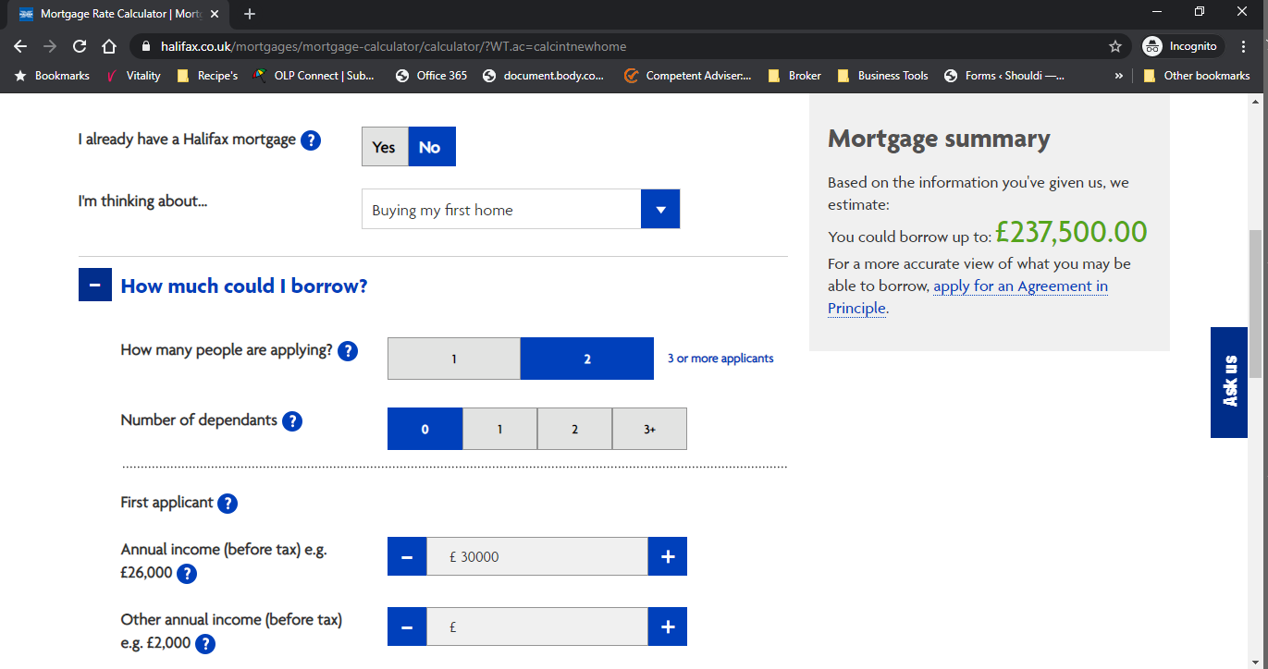
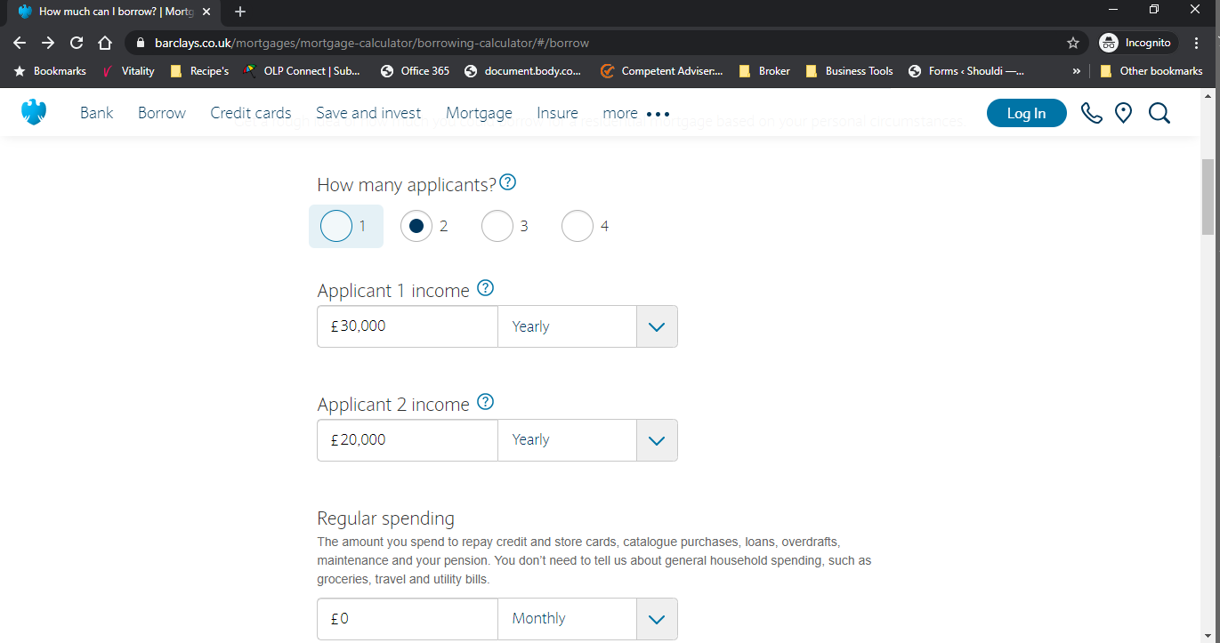
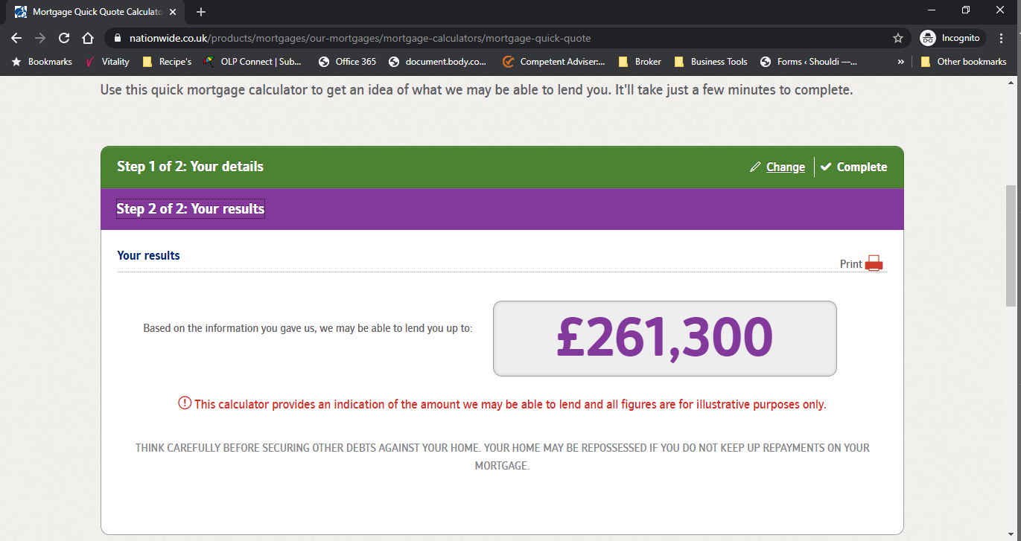
MORTGAGES
HOW MUCH CAN YOU BORROW
Online Mortgage calculators
Agreement in principle

Slide 22
MORTGAGES
RAISING DEPOSIT
Save the money
Government Help To Buy
Bank of Mum & Dad
Notes:
Shared ownership
Up to 75% of value
Pay rent on the rest
Equity loan
New builds only
Loan of up to 20% of the value

Slide 23
MORTGAGES
OTHER COSTS TO THINK ABOUT
Solicitors Fees - £1500
Survey Fees - £500
Arrangement Fees - £1,000
Stamp Duty - £0
Broker Fees - £0
Total - £3,000

Slide 24


MORTGAGES
MORE INFORMATION
HOME
BUYERS
GUIDE

Slide 25
GOVERNMENT SUPPORT
What are you entitled to

Slide 26

BEREAVEMENT SUPPORT PAYMENT
Receiving Child Benefit
No Child Benefit
£3,500 Lump Sum
£350 per month for up to 18 months
£2,500 Lump Sum
£150 per month for up to 18 months
https://www.gov.uk/bereavement-support-payment

Slide 27
INVESTING MONEY
Making cash work harder

Slide 28
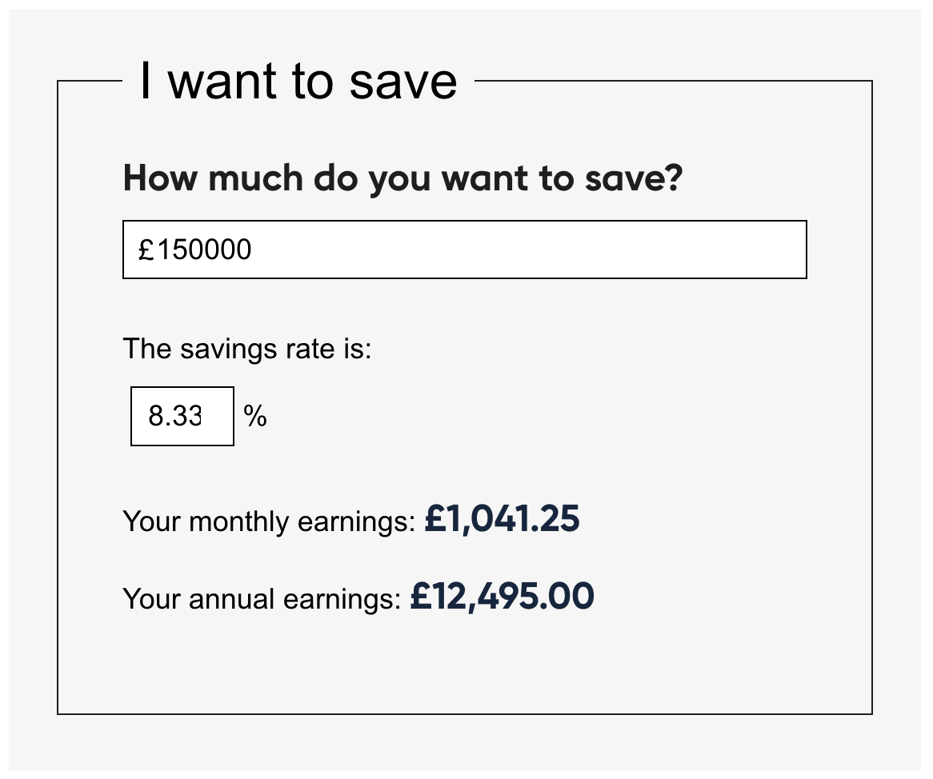
IS IT WORTH INVESTING YOUR MONEY
Always seek independent advice before investing
The value of investments can rise and fall so you could get back less than you invest
Stag Protect are NOT investment advisors
Stocks and Shares
8.33% return over the last 25 years.

Slide 29
DISASTER PLANNING
Making sure you don’t get let down when you need your cover

Slide 30
DISASTER PLANNING
WHY SHOULD YOU CARE
Low confidence in solutions
Terms not fully understood
Financial health
Survey results
Life policies not in trust

Slide 31

DISASTER PLANNING
FRAMEWORK
Life Cover
Income Protection
Critical Illness
Buildings& Contents
Notes:
Bullet proof

Slide 32
LIFE COVER

Slide 33









LIFE COVER
IS YOUR POLICY IN TRUST
Your Estate
Estate Valued
Life Policy
NOT IN TRUST
Any IHT Paid
Paid Quickly
If your policy is not in trust, have your expectations been met?
Tax Free
Notes:
Costs vary

Slide 34
WHAT ABOUT ILLNESS

Slide 35








CRITICAL/SERIOUS ILLNESS
WHAT DOES IT DO
Immediate
financial security
Potential Impact
Critical Illness Cover
Get
Ill
Lost your job
Possibly your home
Buy
Cover
Pays out if condition is covered and meets the clinical criteria
Uncertain future
Income?
Gov Benefits:
Inc SSP up to £99.35 pw
Limited housing options
Earning
money
Notes:
In addition to or instead of CIC

Slide 36






INCOME PROTECTION
WHAT DOES IT DO
Sick pay
ends
Sick Pay?
Yes
Dr’s
Note
Yes
Still
Ill?
No
Insurance?
Yes
Financial
Security
Buy
Cover
Get
Ill
No
Uncertain future
Income Protection
Income?
Gov Benefits:
Inc SSP up to £99.35 pw
John
Pays up to 65% gross salary until you return to work or reach retirement age
Earning
money
Benefits vary between providers, this list is neither complete nor exclusive

Slide 37
DISASTER PLANNING
THE FINAL PIECE OF THE JIGSAW
PRIVATE WILL
WHY YOU SHOULD HAVE ONE
Decide how your estate should be distributed
Decide who will take care of your children
Minimise estate taxes
Decide who will administer your estate
Specify gifts and donations
Avoid legal challenges

